Slide 1
Heat Transfer and Heat Exchangers
Jacob Wheeler, Nic Thomas, Matthew Wyble, Nicole Zhang

Slide 2
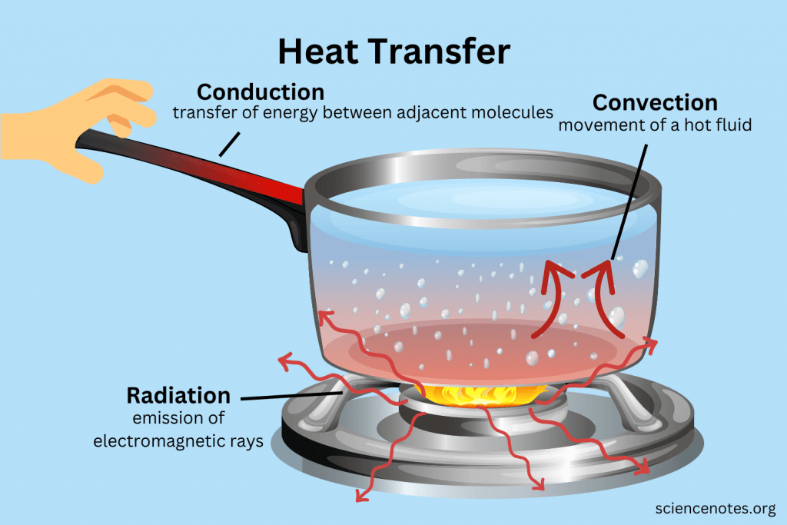
Heat Transfer Introduction and Theory
Heat transfer is the movement of energy between two locations
Heat transfer can occur through 3 main mechanisms:
Conduction
Convection
Radiation
Notes:
Sources: https://sciencenotes.org/heat-transfer-conduction-convection-radiation/ and https://www.britannica.com/science/heat-transfer

Slide 3
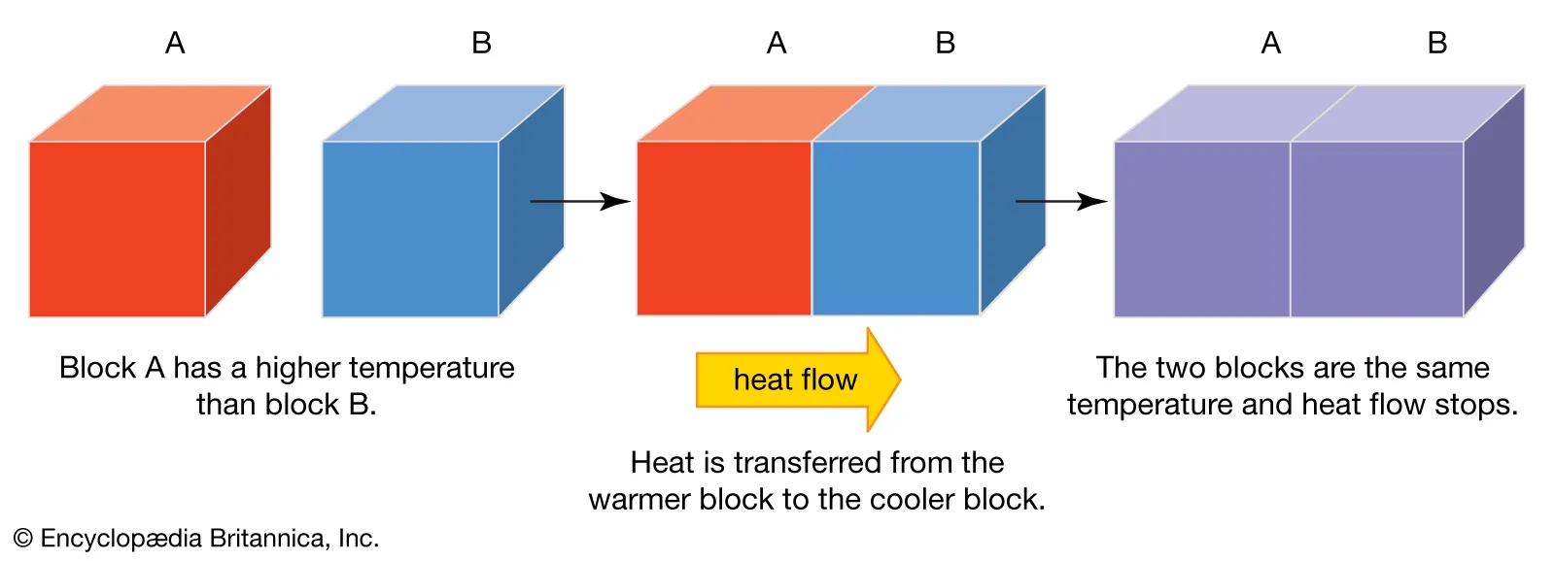
Heat Transfer Theory
The driving force of heat transfer is a temperature gradient
The thermodynamically favorable direction of heat transfer is from a high temperature to a low temperature
Notes:
Sources: https://www.britannica.com/science/heat-transfer

Slide 4
Heat Transfer Theory
Heat transfer has many important governing equations
Fourier’s Law of Heat Conduction:
General Heat Equation:
Notes:
Sources: https://faculty.utrgv.edu/constantine.tarawneh/Heat%20Transfer/HeatTransferBooklet.pdf

Slide 5
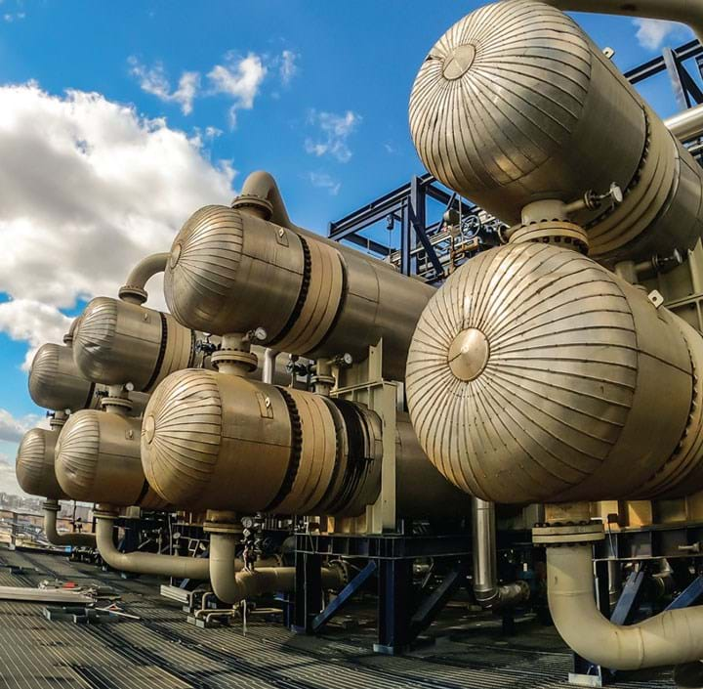
Heat Transfer Applications
Heat transfer applies to many everyday things:
Cooking
Heating homes
In chemical engineering the principles of heat transfer are commonly utilized to design heat exchangers
Heat exchangers can be utilized in many applications of chemical engineering
Notes:
Sources: https://www.thechemicalengineer.com/features/rules-of-thumb-heat-exchanger-selection/

Slide 6
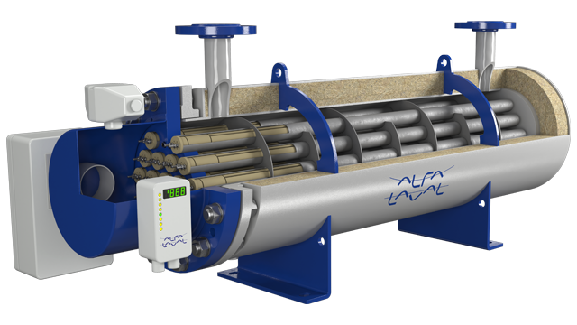
Heat Exchanger Introduction
Heat exchangers are designed to transfer heat from one fluid (gas/liquid) to another
Have a fundamental role in maintaining desired temperatures and to enhance heat recovery
Improving energy efficiency leads to environmental sustainability
Examples:
HVAC
Power generation
Manufacturing

Slide 7
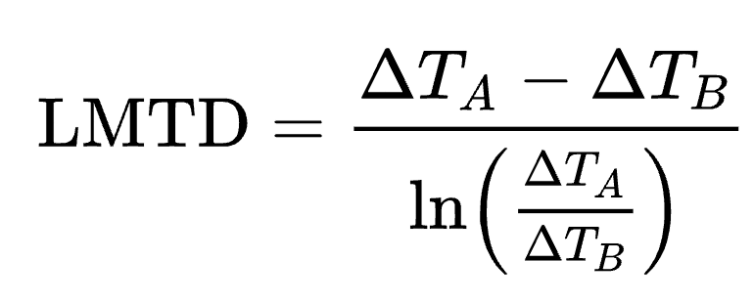
Heat Exchanger Theory
Co-Current Flow
Counter-Current Flow
Co-current flow used when there is a modest temperature difference
When maximizing heat transfer efficiency, counter-current is used
Main Heat Transfer Rate Equation
Logarithmic Mean Equation

Slide 8
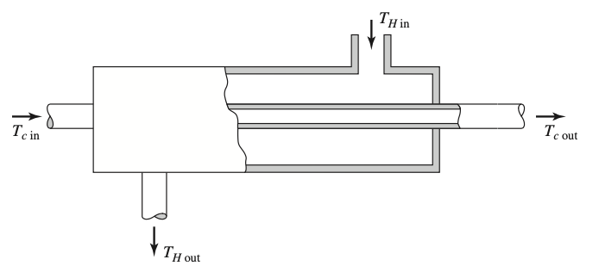
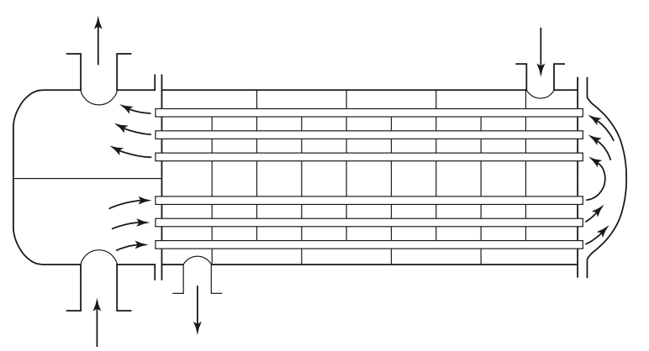
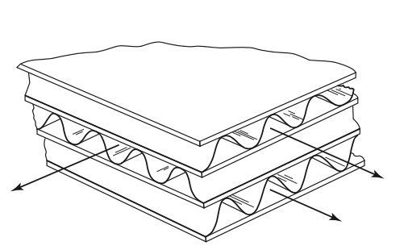
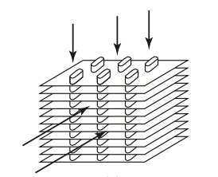
Heat Exchanger Types
Single-pass vs multipass
Parallel vs crossflow
Plate
Concentric tubes
Shell-and-tube
Compact

Slide 9
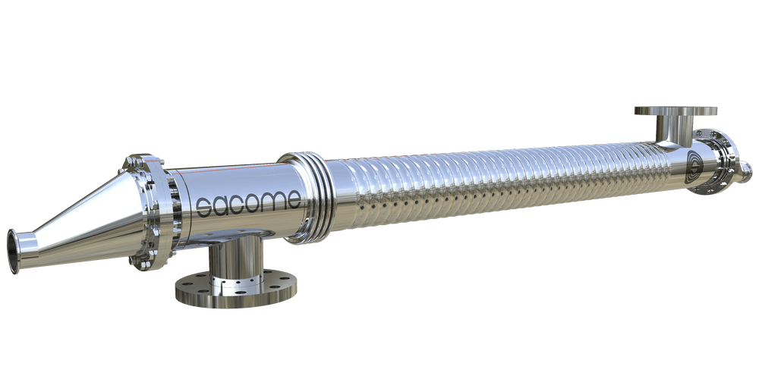
Heat Exchanger Applications
Applicable industries:
Chemical
Food
Oil and gas
Pharmaceutical
Many more!
Notes:
https://www.sacome.com/en/pharmaceutical-multitube-heat-exchanger/

Slide 10
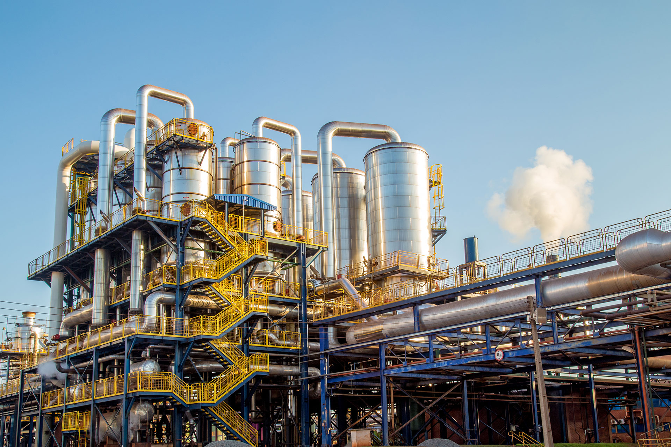
Heat Exchanger Applications
Industrial Sugar Production
Juice Clarification
Shell-and-tube
Plate
Syrup Cooling
Double pipe
Notes:
https://www.grecianmagnesite.com/Sugar-Refining

Slide 11
Heat Exchangers in Aspen Example

Slide 12
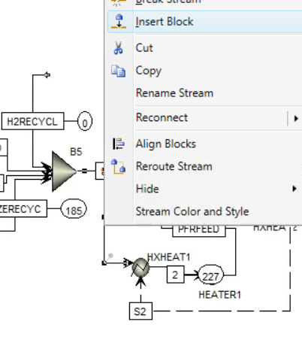
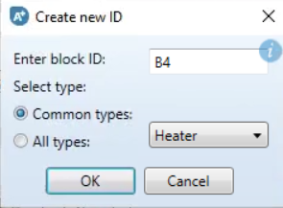
Inserting Heat Exchangers in Aspen
Right-click on Stream
Model Palette

Slide 13
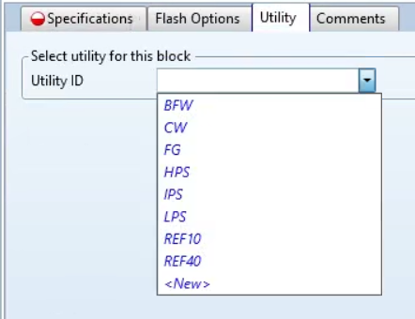
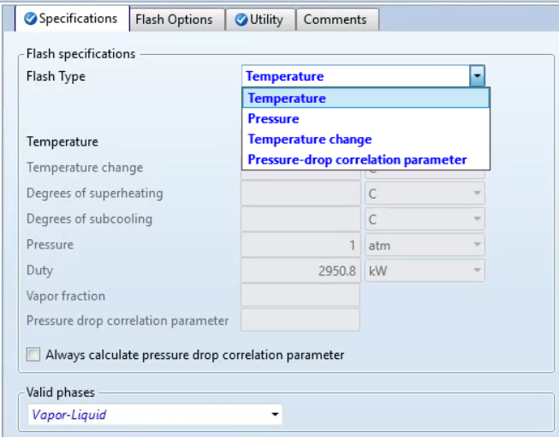
Heat Exchangers Specifications
Utility Selection
Specifications

Slide 14
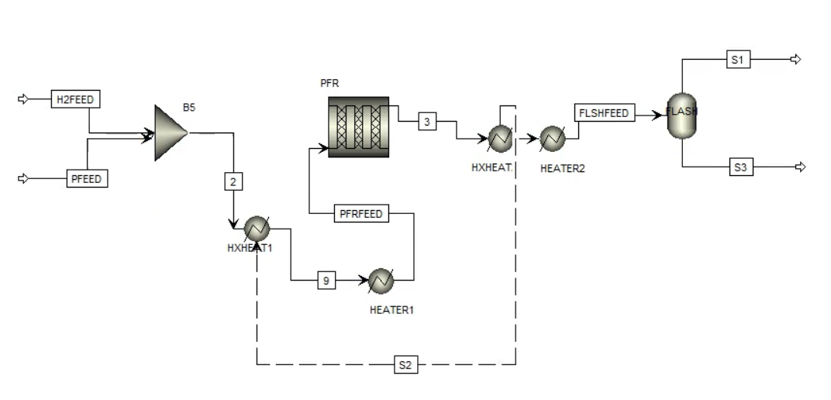
Addition of Heat Exchangers and Heaters/Coolers in Aspen
One Heater + One Cooler = One HX
Heat Stream

Slide 15
References
Edreis Edreis and A. Petrov (2020). Types of heat exchangers in industry, their advantages and disadvantages, and the study of their parameters. IOP Conf. Ser.: Mater. Sci. Eng. 963 012027
Shell-and-tube heat exchangers. Alfa Laval. (n.d.). https://www.alfalaval.us/products/heat-transfer/tubular-heat-exchangers/shell-and-tube-heat-exchangers/
Plate Heat Exchangers for Sugar. HFM (n.d.) https://www.hofmann-heatexchanger.com/solutions/plate-heat-exchanger-for-sugar
MIT. (n.d.). 18.5 Heat Exchangers. 18.5 heat exchangers. https://web.mit.edu/16.unified/www/FALL/thermodynamics/notes/node131.html
Helmenstine, A. (2023, January 18). Heat transfer - conduction, convection, radiation. Science Notes and Projects. https://sciencenotes.org/heat-transfer-conduction-convection-radiation/
Encyclopædia Britannica, inc. (2024, February 2). Heat transfer. Encyclopædia Britannica. https://www.britannica.com/science/heat-transfer
IChemE. (n.d.). Rules of thumb: Heat exchanger selection. The Chemical Engineer. https://www.thechemicalengineer.com/features/rules-of-thumb-heat-exchanger-selection/

